Slide 1
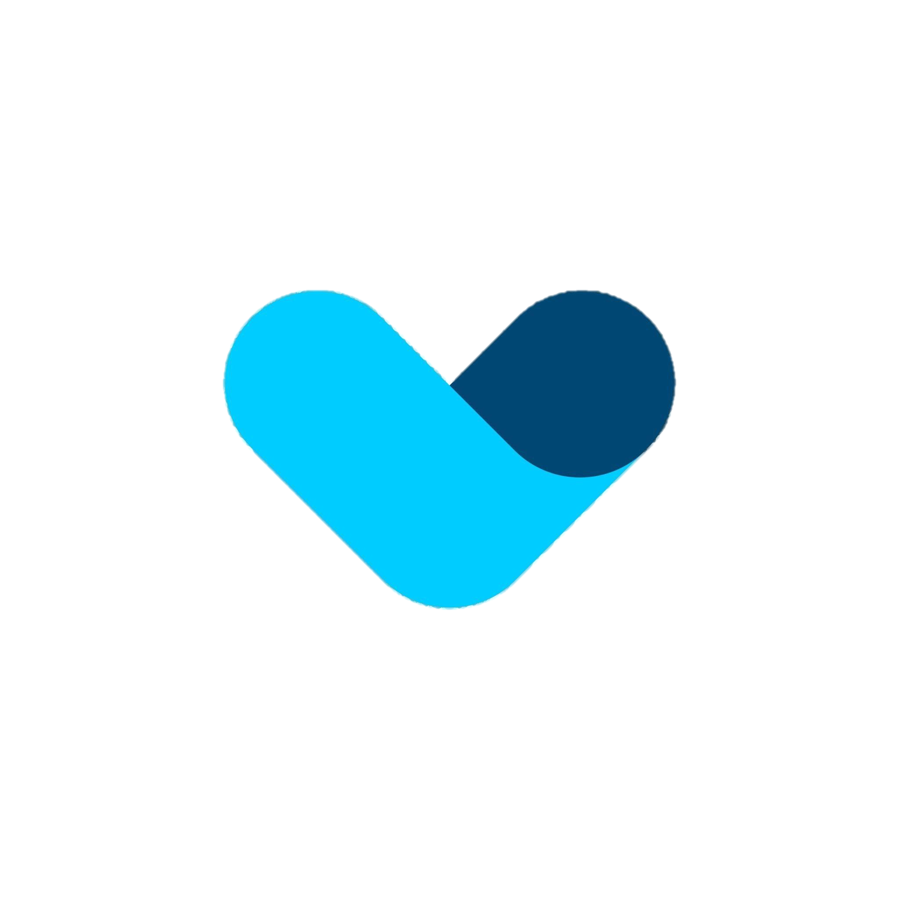
Micro SAAS Startup Session 1
SAAS Startup Session

Slide 2
Selecting a customer Acquisition channel 1 Define Your Objectives
Learning: Focus on gathering insights about engagement, audience interest. This is crucial for startups in early stages or expanding to new audiences.
Cost: Optimize your cost per acquisition (CPA) to maximize your budget's efficiency.
SAAS Startup Session

Slide 3
Selecting a customer Acquisition channel 2 Identify Your Constraints
Time: Is there a specific window for reaching your target audience, or are you running out of time due to financial constraints?
Financial Situation: Is your company well-financed, or are you self-funding (bootstrapping)? Do you require additional funds to sustain your operations?
Audience Focus: Is it necessary to target a highly specific group of individuals?
Legal Challenges: Are you challenging established industries with a history of legal disputes,
SAAS Startup Session

Slide 4
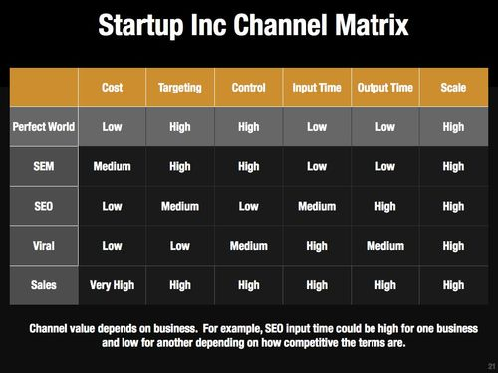
Selecting a customer Acquisition channel 3 Create a Channel Matrix
Define a way to compare channels based on similar attributes based on constraints and objectives.
”content marketing could be broken down into blogging, guest blogging, info graphics, webinars” Brian Balfour
SAAS Startup Session
5 Steps To Choose Your Customer Acquisition Channel — Brian Balfour

Slide 5
Testing an MVP
Landing Pages: First contact points for customers, also serving as MVPs for testing your product.
Ad Campaigns: Run targeted ads on platforms like Google and Facebook to gauge product appeal.
Fundraising: Use crowdfunding platforms like FundKiss to validate market interest and engage early adopters.
Explainer Videos: Showcase your product's user experience to attract early users.
Concierge MVPs: Deliver a customized service to select customers, revealing customer preferences.
Single-Feature MVPs: Focus on one core feature to simplify development and user focus.
Pre-Order Pages: Present your product to potential customers, enticing them to purchase before it's built.
SAAS Startup Session
5 Steps To Choose Your Customer Acquisition Channel — Brian Balfour

Slide 6
Improving a Business Plan
Conduct Comparative Analysis:
Detail Staffing Structure:
Analyze Financial Projections:
Create thorough financial projections that encompass startup and operational costs, including production expenses, business running costs, and overhead.
Investors and lenders want to know who will manage your business. Include an organizational chart showing roles, responsibilities, and reporting lines.
include a comparative analysis that examines indirect competitors and alternative choices customers make.
SAAS Startup Session
5 Steps To Choose Your Customer Acquisition Channel — Brian Balfour

